Slide 1
Stage 10: Promoting and packaging products

Slide 2
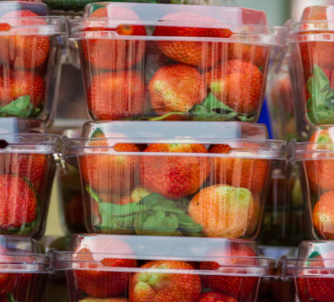
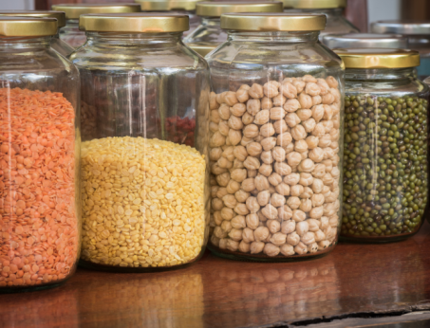
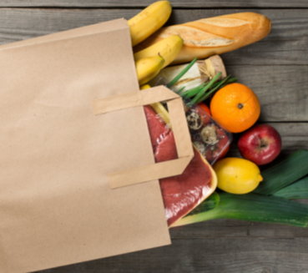
Learning Objectives:
• To design and conduct a fair investigation
• To investigate which material will keep food fresher for longer
• To design and make packaging
• To write and perform promotional material
Talk to your group:
How many different packaging materials can you think of?

Slide 3
Packaging investigation
Today, we will be designing a fair test to compare the effectiveness of packaging materials.
Talk to your group: How might we do this?
What is a fair test?

Slide 4
Carrying out a fair test
A fair test is a controlled investigation that compares two things. In order for a test to be fair or well controlled, we have to make sure that only one thing (this is called a variable) is changed and everything else is kept the same.
A variable is anything that can affect the results we are observing or measuring.
In our investigation, we will use four slices of bread from the same loaf. The one variable that we will change is the packaging that it is contained in. Then we will observe what happens.
By only changing one thing (the packaging material) and keeping everything else the same, we can use our observation skills to decide which is the most effective.

Slide 5
Investigation planning:
Think about variables that you will need to control (keep the same) for this investigation.
How will you measure which packaging was the most effective?
Write up your investigation plan and explain why you are changing your variables or keeping them constant.

Slide 6
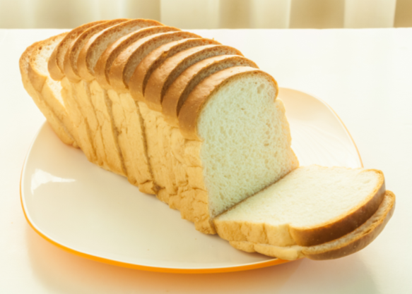
Your investigation
In your groups, set up your investigation. Don’t forget to leave one slice of bread without packaging. This will be your control.

Slide 7
Observation diary
You will be observing your bread slices at regular intervals across a two week period. Look through the cling film windows you have made in the packaging materials and record your observations with diagrams each time.
It is important that you do not remove the bread from the packaging at any point in the investigation!

Slide 8
Reporting your results
Observe your final results closely and write a conclusion to explain which packaging material was the most effective.
Think critically: how well-controlled was your investigation?
Could you have improved your design? How?

Slide 9
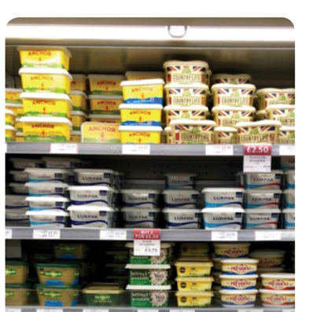
Packaging
Most of food products in supermarkets come in packaging.
Some packaging can be recycled but a lot of it cannot.
Lots of our food is packaging in plastic that cannot be recycled.

Slide 10
Notes:
Plastic waste does not decay quickly. Therefore, plastic waste that ends up in the oceans is likely to remain there for decades.
There are many examples of where animals have become entangled in plastic waste such as plastic bags, bottle and discarded nylon fishing nets.

Slide 11
Notes:
In the UK, we now recycle a lot of our waste plastic. However, plastic in the form of polythene and clingfilm ends up in landfill.
Some households do not recycle waste and waste from litter bins in public places is rarely sorted for recycling.

Slide 12
Notes:
All these reasons are important.
Food is kept fresh because packaging may keep the food dry, keep microbes out or may enclose a protective atmosphere such as nitrogen gas (to stop food oxidising and to stop some microbes from multiplying).

Slide 13
Notes:
Children will be very familiar with modern packaging materials. They may be less familiar with paper, glass and tin packaging.

Slide 14
Notes:
Children will be very familiar with modern packaging materials. They may be less familiar with paper, glass and tin packaging.

Slide 15
Notes:
Reinforcement of Slide 6. This is to emphasise that plastic packaging is beneficial provided it is disposed of and processed responsibly.

Slide 16
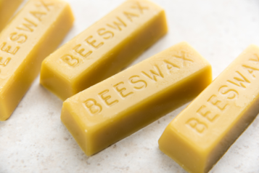
Making eco-friendly packaging
We are going to make our own beeswax wraps- environmentally friendly packaging materials that are an alternative to plastic cling film.
Decorate your fabric square with your branding.
Line your ironing board with a layer of newspaper and grease-proof paper.
Place your fabric square on the grease-proof paper and sprinkle the grated beeswax over it.
Place a second sheet of grease-proof paper over the fabric.
Iron over the grease-proof paper to melt the wax and add more wax to any areas that do not look darker.
When all the beeswax has melted, leave the fabric to dry.

Slide 17
Designing your packaging
Design and make the packaging for your product.
Think about the materials you will use- you might like to incorporate your beeswax wrap.
Think about how to appeal to your target market.
How will you make your product stand out from the competitors on the shelf?

Slide 18
Promotion
Businesses use promotion to tell possible customers all about their product.
Promotion is used to advertise the benefits of the product and why it is better than competitors.
You can use promotion to persuade customers to buy your product.
Can you think of any ways that businesses do this?

Slide 19
Methods of Promotion
Advertising: TV or magazine adverts, posters, leaflets, flyers, brochures
Special offers: price reductions, competitions, free samples
Endorsements by celebrities

Slide 20
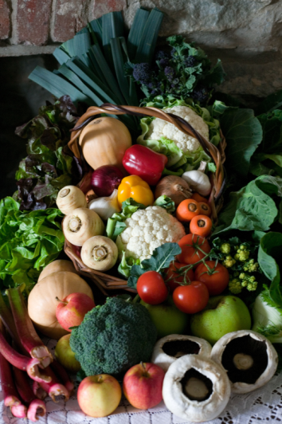
Exploring food advertising
Look at the food advertising on your table.
How do they encourage customers to buy more of their products?
Can you find any of the key features of persuasive writing?

Slide 21
Promoting your product
Design a poster, flyer or leaflet to promote your product.
Think about how to appeal to your target market.
What features of language will you need to persuade people to buy it?
Think about other promotional strategies that you can use on your advert. For example, special offers.

Slide 22
Promoting your product
Write and perform a television or radio advertisement for your product.
Think about how to appeal to your target market.
What features of language will you need to persuade people to buy it?

